Slide 1


SAEISS Aero Design Challenge 2020, Regular Class SASTRA Deemed To Be University, Thanjavur Technical Presentation
By
Team Udyat ADC2020114

Slide 2
Project Planning
Project approach
To practically apply our Theoretical Knowledge combined with our thought processes. Mimicking a fully functional aerospace engineering firm.
Project Timeline
Team Registration and Memberships
Initial Discussions
Literature and Design Report Study
Sub-System Allocations and Working
Design Report completion and Submission
Fabrication /Technical Preparation
Test Flight and changes
Order of Components and Materials
Design Approach
Conceptual Design
Detailed Design

Slide 3
SAE AERO-DESIGN COMPETITION ROADMAP
Understanding problem-statement
Team meetings
Weight estimation
August
September
2019
Semester exams
Material selection
Dealers contact
October
Modelling
Design report
December
November
Attending workshop
Basic calculations
2019-2020
2020
Final design report
Scale down model
Fabrication
Technical presentation
January
February
TEAM UDYAT
* Literature study is a part of all months

Slide 4
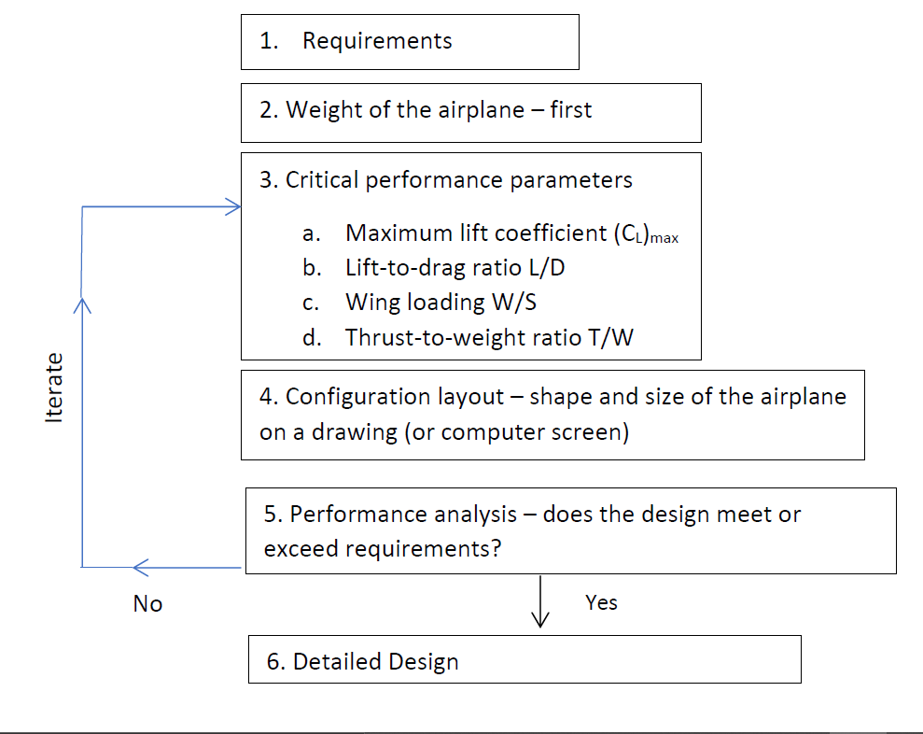
Design Approach
Conceptual Design
Detailed Design
3-D drag analysis
Structural Analysis.
Power Plant.
Material Selection.
Fabrication Feasibility.

Slide 5
Procedure
UDYAT plane
Weight estimation
Wing design
Empenage
Fuselage
C.G location
Landing gear

Slide 6
Requirements and Constraints ( Include Sae plane)
FRP and Lead Prohibited
Propulsion System
Problem statement
Ss
SAE
Requirements and Constraints
Total Take off distance 200ft.
Total Landing distance 400ft.
Total Length <170 inches .
2kg <Weight<5kg
Additional Constraints
Time
Fabrication Feasibility
Cost

Slide 7
FRP and Lead Prohibited
Propulsion System
Problem statement
SAE
Requirements and Constraints
Total Take off distance 200ft.
Total Landing distance 400ft.
Total Length <170 inches .
2kg <Weight<5kg
Additional Constraints
Time
Fabrication Feasibility
Cost

Slide 8
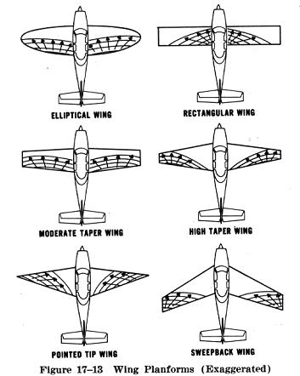
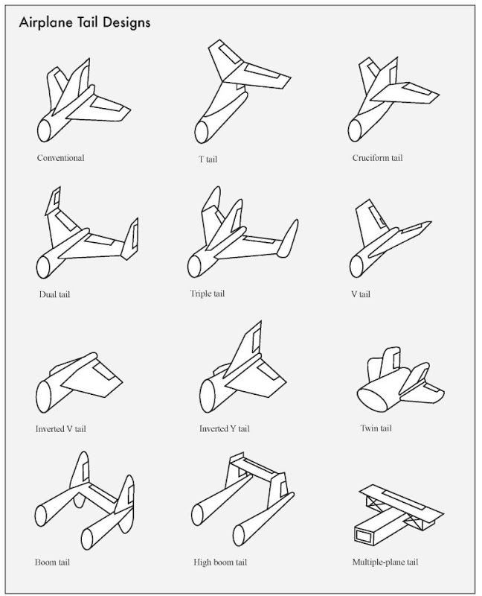
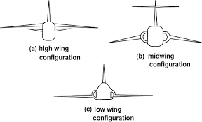
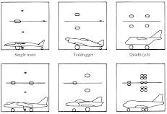
Configuration Selection and Trade Studies
Evaluation Criteria:
Less impact during landing
Laterally stable
Smooth finish of Fuselage
Ease of Wing-Fuselage Assembly.
Evaluation Criteria:
Induced drag
Weight Reduction
Near Elliptical Distribution
Manufacturability
Evaluation Criteria:
Reduced Parasite drag
Reduced rudder-induced roll
Free of fuselage wake
Reduced Cantilever stress
Evaluation Criteria:
Prevents Ground looping
A
Ad
Fuselage Evaluation Criteria:
Innovation
Reduced Influence of Wing wake on Tail
Ease of manufacturing

Slide 9
Vehicle Sizing
Volume Coefficients
Lift Requirement
Airfoil Selection
Horizontal Stabilizer Dimensions
Payload Requirement
Wing Dimensions
Fuselage Dimensions
Vertical Stabilizer Dimension
Avionics Requirement
Vehicle was sized based on competition requirements, meanwhile considering the aerodynamic characteristics and structural integrity.
Aerodynamic parameters and Fabrication feasibility were considered, iterated and necessary design changes were made.

Slide 10
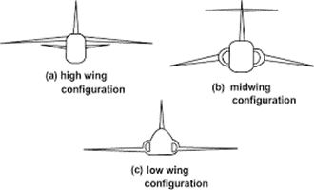
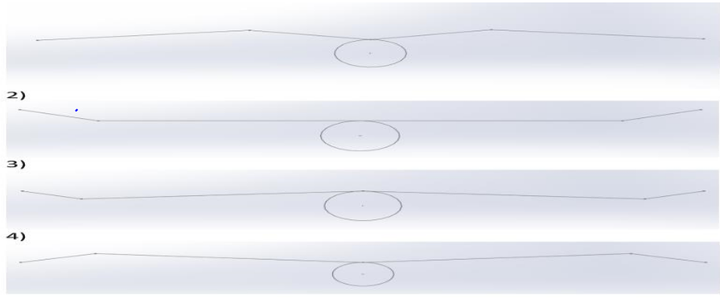
Wing
Wing configuration
Wing planforms
Airfoils
Wortman fx-63-137
E-423
S1210
S1223
Wing specifications

Slide 11
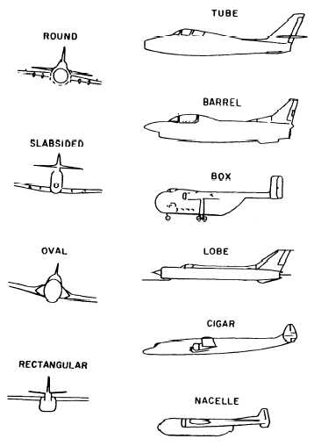
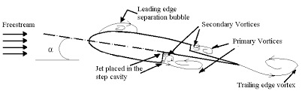
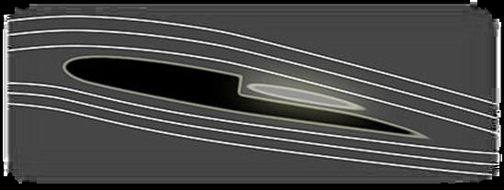
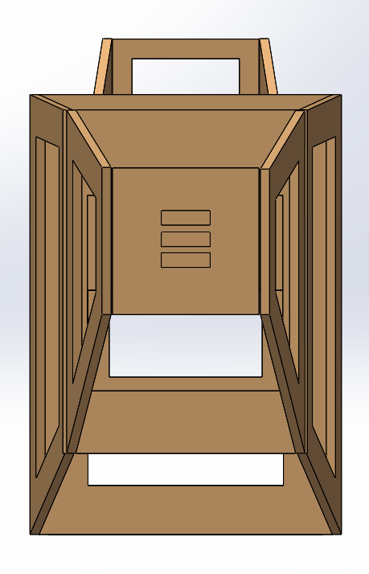
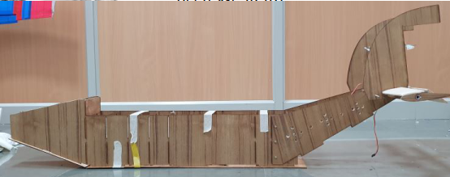
Fuselage
INNOVATION:
The purpose of the step, it is claimed, is to allow some of the displaced air to fall into a pocket behind the step and become part of the airfoil shape as a trapped vortex. This purportedly prevents separation and maintains airflow over the surface of the airfoil. A similar step is made after the diverging part of fuselage to attach the flow and reduce the slope of decrease in lift.
Fuselage front view
Fuselage side view

Slide 12
Innovation
The purpose of the step, it is claimed, is to allow some of the displaced air to fall into a pocket behind the step and become part of the airfoil shape as a trapped vortex. This purportedly prevents separation and maintains airflow over the surface of the airfoil. A similar step is made after the diverging part of fuselage to attach the flow and reduce the slope of decrease in lift.

Slide 13
Vehicle Sizing
Aerofoil Selection
(Wind-Turbine blades)
Performance Parameters
Maximum Lift Co-efficient
Maximum L/D Ratio
Wing-Loading
Informal Optimisation of Cruise-Velocity
Optimisation of Aspect Ratio
WING-DIMENSIONS

Slide 14
Payload Requirements
Manufacturing Ease
Avionics Requirements
Fuselage Dimension
Volume Coefficients
Wing- Dimensions
Aerofoil
Vertical and Horizontal Stabiliser
Vehicle was sized based on competition requirements, meanwhile considering the aerodynamic characteristics and structural integrity.
Aerodynamic parameters and Fabrication feasibility were considered, iterated and necessary design changes were made.

Slide 15
Vehicle Sizing
Performance parameters
Wing loading
Max L/D ratio
Aspect ratio
Airfoil
Max. lift coefficient
Wing Dimensions
Cruise velocity
Stabilisers
Avionics requirement
Volume coefficients
Payload requirements
Fuselage dimensions
Manufacturing Ease

Slide 16
WING
Required Lift L=5.75Kg
Assumed Speed Vc=10m/s
Airfoil= S1223
For Wing: C_{Lmaxw}= C_{lmax} * 0.95= 2.177
C_{L ideal} = C_{l ideal} *0.95= 1.0973
For Aircraft: C_{LAmax} = 2.177* 0.9=1.95
C_{LA ideal}= 1.0973*0.9= 0.98
Lift = ½* 𝜌∗𝑉𝑐2∗𝑆∗𝐶_{Lmax.}
56.4075= .5*1.225* 100* S* 1.95
Span area (S)= .4722 m2. = 732in2.
Airfoiltools.com
Span Length (b)= 71.58in
Mean Aerodynamic Chord MAC = 10.22in
Literature Study and Optimisation of Aspect Ratio.
A.R= 7
Landing Distance
𝑆𝑔=1.21∗(𝑊/𝑆)/ (𝑔∗𝜌∗𝐶_{𝐿A𝑚𝑎𝑥}∗𝑇/𝑤)
T/W= (1.21*20)/ (32.2*0.002377*1.95*200) = 0.81.

Slide 17
Tail-Section
Horizontal Stabilizer
(PITCH STABILITY)
Literature Study NACA 0009, Volume Coefficient 0.6
Vertical Stabilizer
(DIRECTIONAL STABILITY)
Literature Study Volume Coefficient 0.05
Vv =. (𝑆𝑣∗𝐿𝑣)𝑆𝑤∗𝑏
Formal Optimisation of Span area
130 sq. in
Formal Optimisation of Span area
83 sq. in
AR_{h}=(2/3)AR_{w}=4.66
Span length=24.61 in
chord=5.27 in
Elevator chord=2 in
Elevator length=24.61 in
AR_{h}=2.5
Height=12 in

Slide 18
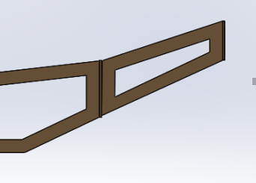
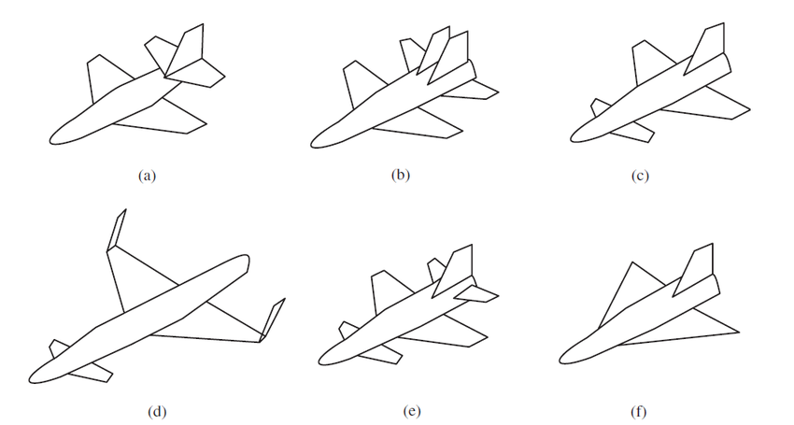
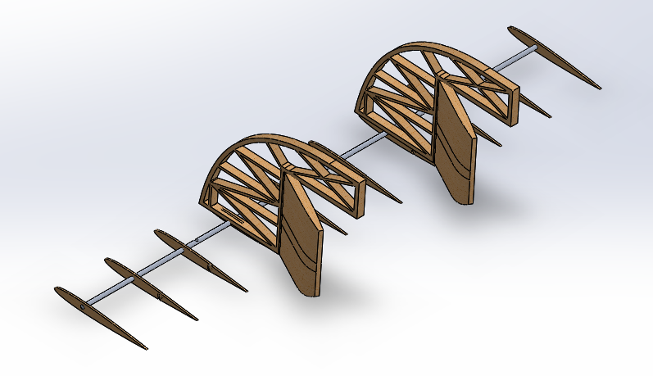
Empennage
Tail cone side view
Horizontal & vertical Stabilizer
Airfoil-NACA0009
Tail isometric view

Slide 19
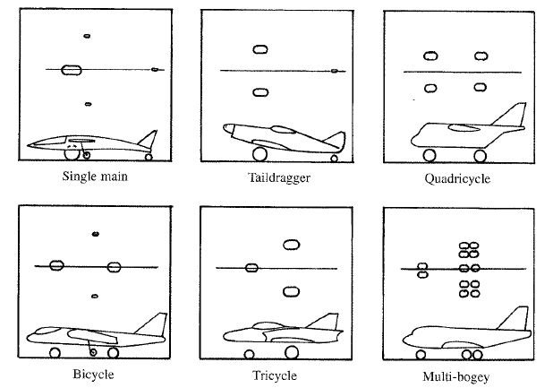
Landing gear

Slide 20
Centre of Gravity and stability
Xflr
COG location using XFLR5: 1.997(from MAC of 10.1 in)
Analytical
X_{np} = 3.027 inches (for 10.1 inches MAC).
We chose the mid value of Stability margin which is 0.10.
X_{cg} = 2.017 inches (from MAC of 10.1 inches).

Slide 21
Stress analysis and Material Selection
𝐶𝑝=(𝑃𝑜−𝑃𝑎)/ 5∗𝜌∗𝑉_{𝑐}².
Distance Between Ribs:
 | Density, g/cc | Strength, MPa | Specific strength | Youngs Modulus, GPa | Flexural Modulus, GPa | Elongation, % | Fatigue Mpa
Balsa Wood | 1.63 | 30 | 18.40 | 3.71 | NA | NA
Depron | NA | NA | NA | NA | NA | NA
Corrugated plastic | NA | NA | NA | NA | NA | NA
Elasto foam | NA | NA | NA | NA | NA | NA
FRP | 1.5 | 85 | 56.67 | 3.4 | 3.6 | 5
PLA | 1.25 | 65 | 52.00 | 3.5 | 4.5 | 12
ABS | 1.08 | 55 | 50.93 | 3.1 | 2.5 | 20
Nylon 6 | 1.12 | 70 | 62.50 | 3.1 | 2.6 | 35
Nylon 66 | 1.14 | 90 | 78.95 | 2.9 | 2.4 | 45
PEEK | 1.3 | 95 | 73.08 | 4 | 3.8 | 45
Torlon | 1.42 | 170 | 119.72 | 4.9 | 5 | 15
Al 7075 T6 | 2.7 | 570 |  | 71GPa |  | 10 | 300
𝑃𝑜−𝑃𝑎= 350 Pa
Iterative Process
Material Selection Trade-Off

Slide 22
Empirical Results

Slide 23
Lessons Learnt
We have the aerodynamic knowledge, the structural materials, the powerplants, and the manufacturing capacities to perform any conceivable miracle in aviation. But miracles must be planned, nurtured, and executed with intelligence and hard work”.
- Glenn L. Martin, aviation pioneer and manufacturer, 1954.
Checking the availability of necessary components before coming to design conclusions.
Fabrication and Manufacturing required a yet another different set of skill.
Time Management
Finance management

Slide 24
Queries?

